Slide 1

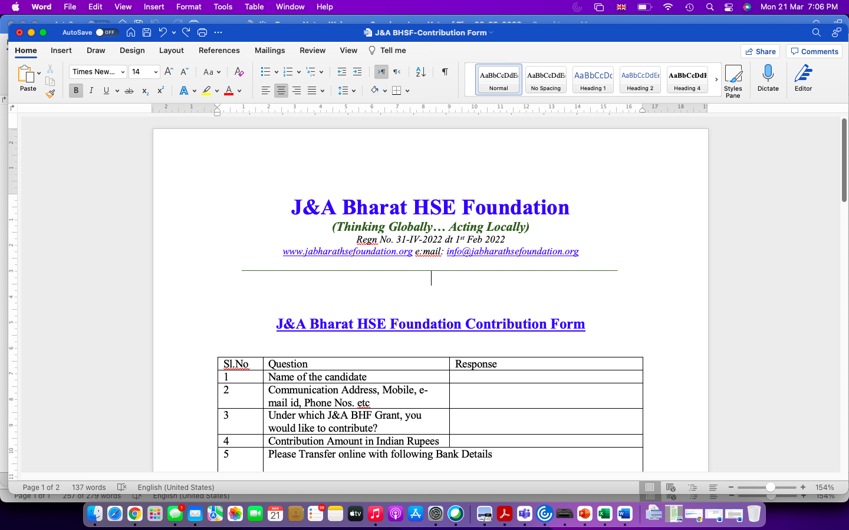
J&A BHF Keval Shanthi Student Scholarship Receipients 2022

Slide 2

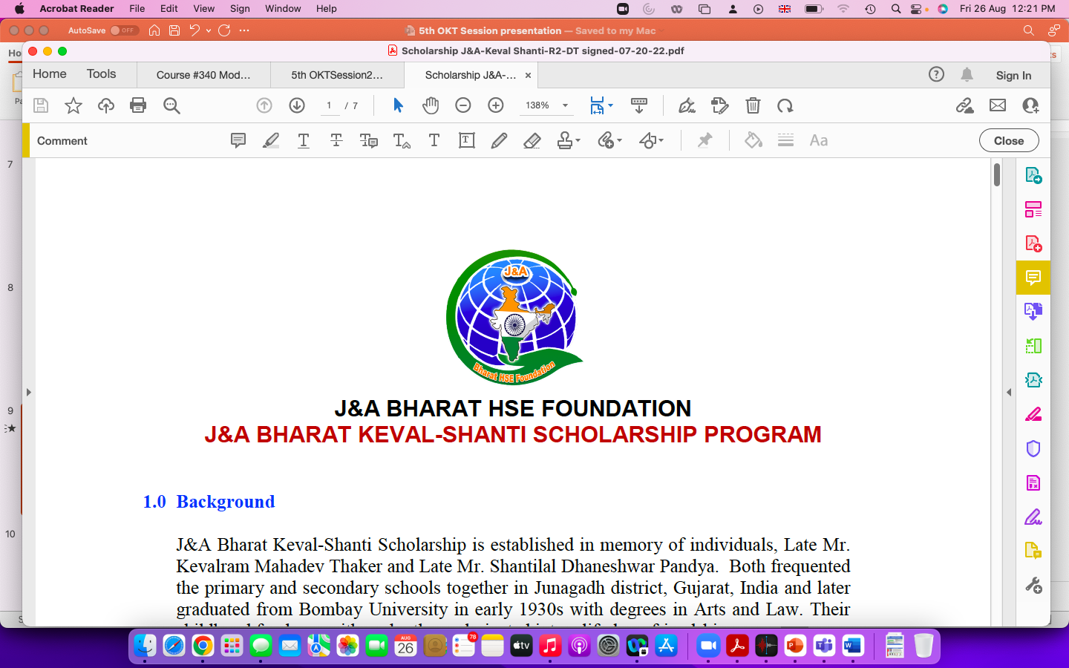

Announcement of J&A Bharat Keval-Shanti Scholarship Program

Slide 3


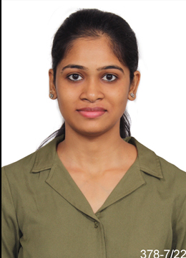

Announcement of Receipients- NICMAR
S.NO | Name of Institution | Program Title | Duration | Name of student | Photo of the Student
1) | NATIONAL INSTUTUTE OF CONSTRUCTION MANAGEMENT(NICMAR) - Autonomous University | PGP-HSEM | 1 year | Ms Vuda Srilekha

Slide 4
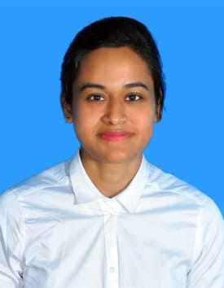
Announcement of Receipients- NICMAR
S.NO | Name of Institution | Program Title | Duration | Name of student | Photo of the Student
2) | NATIONAL INSTUTUTE OF CONSTRUCTION MANAGEMENT(NICMAR) - Autonomous University | PGP-HSEM | 1 year | Ms Satabdi Priyadarshini

Slide 5
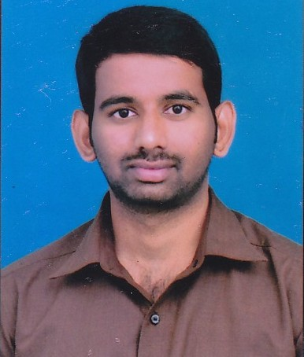
Announcement of Receipients-Connect IT Solutions
S.NO | Name of Institution | Program Title | Duration | Name of student | Photo of the Student
3) | CONNECT IT SOLUTIONS - Affiliated to State Board of Technical Education, Telangana State Government | Certificate Program in Industrial Safety | 1 Year | Mr. Vemuri Aditya

Slide 6
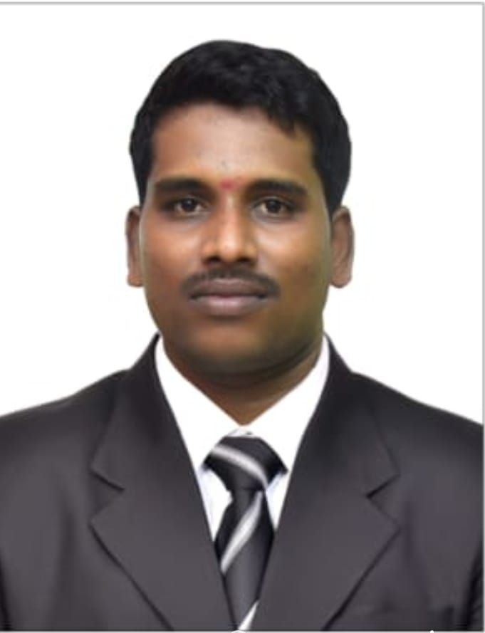
Announcement of Receipients-Connect IT Solutions
S.NO | Name of Institution | Program Title | Duration | Name of student | Photo of the Student
4) | INSTITUTE OF ADVANCED SAFETY MANAGEMENT. - Affiliated to State Board of Technical Education, Telangana State Government | Certificate Program in Industrial Safety | 1 Year | Mr. Thadaka Pelli Sravan

